Slide 1
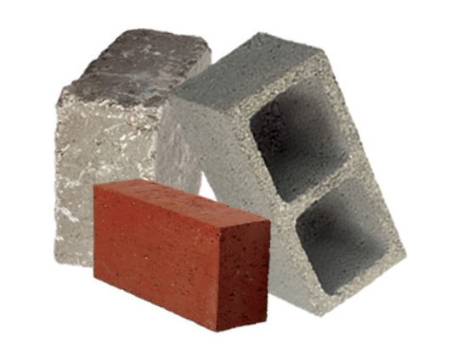
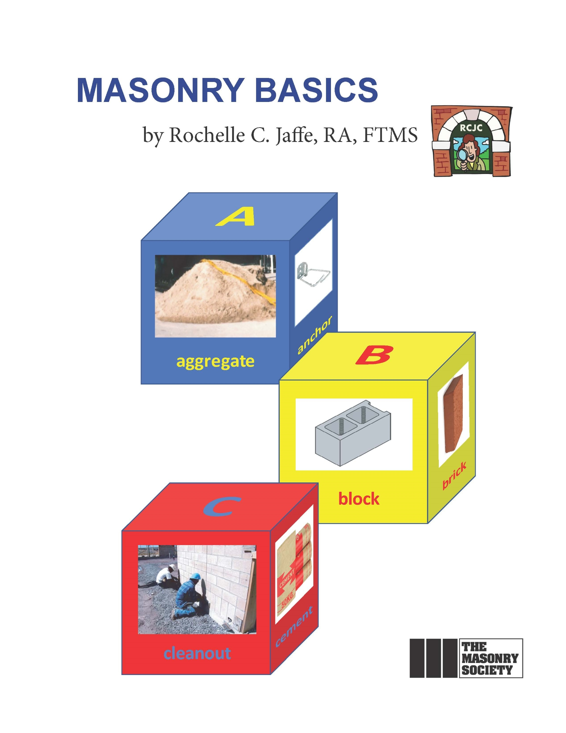
Join The Masonry Society (TMS)
Learn
Benefit
Grow
Contribute
Serve
Find out more about us at: www.masonrysociety.org
Advancing the knowledge of masonry

